Slide 1
Distributed File System using FUSE
Gautam Worah
Pardhakeshwar Pacha
Tapas Mallick

Slide 2
Problem Statement & Description
The Problem Statement: To create a distributed and reliable FUSE backed file system that supports File based I/O.
Description: FUSE provides a very effective abstraction over kernel-level file handling. We use this feature to our advantage to build a distributed file system that utilizes FUSE to perform system calls and file operations.
Multiple data servers store files and communication between all components is implemented using GRPC protocol

Slide 3
Objectives
To build a distributed file system that provides features such as data replication, network and fault tolerance, location transparency, data integrity,
The system should provide coverage against network partition and failure
The file should be replicated in the client from the data server in case it is deleted or corrupted

Slide 4
Architecture Description
The system consists a data pipeline: Client -> Staging Server -> Data Server
The client send data storage or retrieval requests to the staging server that in turn sends it to one of the data server.
Each file is replicated across 3 data servers to ensure protection against corruption and disaster.

Slide 5


High Level Architecture Diagram
Client
FUSE
cat
Server
GRPC
FUSE
Client
VFS
GRPC
ls
GRPC
Client
Replication of file in case file is corrupted in the client
vi

Slide 6

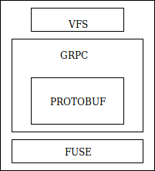

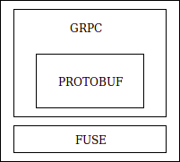
Detailed Architecture Diagram
Data Server
GRPC
GRPC
Staging Server
Client
GRPC
GRPC
Data Server
GRPC
Client
Data Server

Slide 7
Components
Client: Consists of a DFS component that contains FUSE, a GRPC component for communicating with the Staging server, a VFS
Staging Server: Consists of a GRPC component for communication with both clients and data servers, FUSE component.
Data Server: Hold the actual files and data from the client, recieved and responds to requests via GRPC

Slide 8
Features
Data Replication: Each file is replicated across 3 Data Servers to ensure data replication and availability
Server Crash Recovery :The client can re connect to the server automatically even when server fails or when server reboots.
Location and Network Transparency: The client is not affected in case of network failures
3 tier architecture for high scalability and fault tolerance

Slide 9
Challenges
Ensuring data integrity across multiple copies.
Handling the server crash recovery when server reboots or server crashes .
Interfacing FUSE based file systems using GRPC and protobuf
Implementation of GRPC communication using the protobuf library across multiple clients and data servers using Protobuf

Slide 10
Challenges:
Ensuring fast data storage and retrieval
Replicating the file in the client directory from the data server using GRPC and FUSE in case it is deleted

Slide 11
Screenshots

Slide 12
Demo

